Slide 1
Finishing up Fid’Lin
Team 2
Jakob Beckleheimer, Dylan Brownell, Tanner Groll,
Derek Pendleton, & Phil Snider

Slide 2
This iteration we…
Cleaned up the brain tuning function
Created a sequence and state diagram
Created a lessons learned document
Cleaned up the UI
Brushed up on our documents and diagrams
Reduced Inefficient Code

Slide 3
C# and Xamarin Forms
Not your average .NET project.
Plug-ins necessary to do many normal tasks.
  System specific tasks such as timers
Large number of additional libraries to support mobile development.

Slide 4
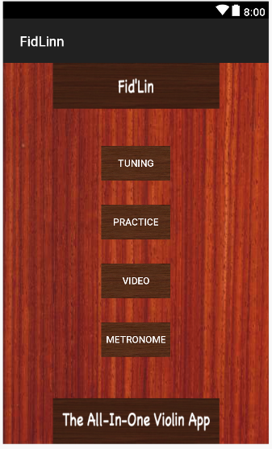
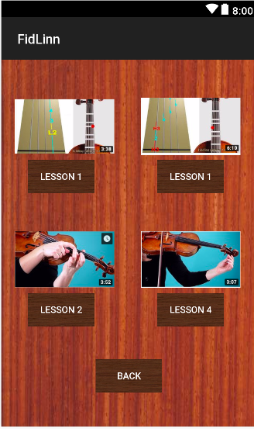
Menu UI / Video Ui

Slide 5
Tuning
Brain Tuning
Push button system
Stop button for convenience
Only one sound at a time

Slide 6
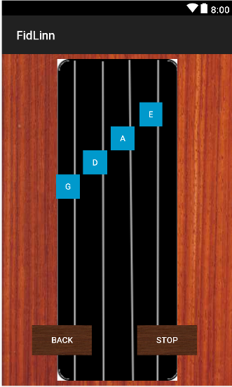
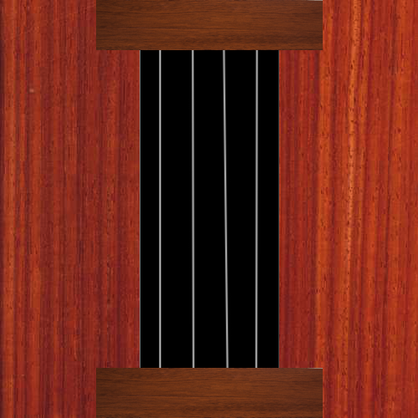
Tuning UI

Slide 7
Scales
User selects a scale type and a key (limited to one selection)
App builds the scale
Displays each note name and finger position for 3 seconds in screen center
Supports Diatonic Major/Minor, Pentatonic Major/Minor, Chromatic scales
Each scale covers a single octave
2 total octaves are covered by the provided scales, first position notes
Changes? Expanded list layout, redesign to one selection grouped by type

Slide 8
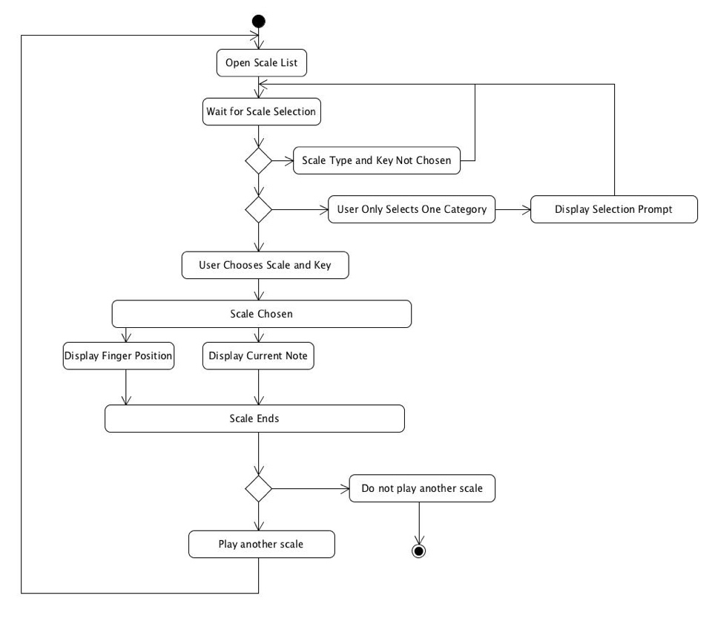

Slide 9
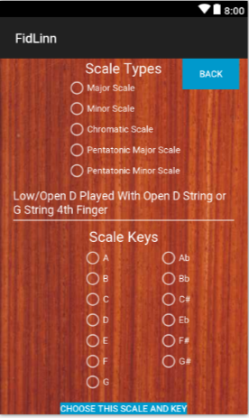
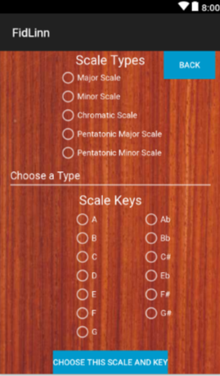
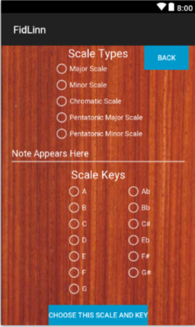
Scales UI
Good Input
Bad Input
Default

Slide 10
Metronome

Slide 11
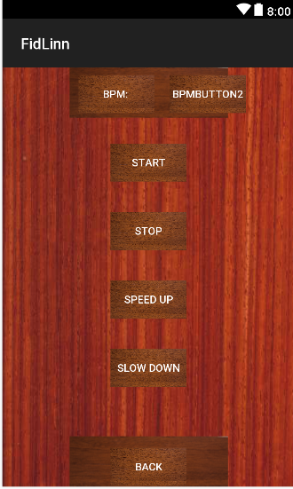
Metronome UI

Slide 12
Improvements from Last semester (Software engineering)
Prioritized documentation more-so
Constant communication throughout the semester
  Remote Desktop
  Team Coding
Have a functional product
Didn’t get (too) behind

Slide 13
What we could have done better as a team
Should have gotten a lot more code completed during Sprint 2 than we did.
Better game plan to take care of all functional requirements
Making sure things aren’t getting completed last minute
Time management

Slide 14
What we have learned from this course
The more communication between the team, the better.
The earlier things get completed, the better.
Procrastination is not your friend.

